Slide 1
Aspects of Romanian experience in development of border regions of EU
STRUTURE:
Theoretical aproach and instruments which follow the political decision to join EU structure – 4 slides
Romania CBC map and personal experience – 4 slides
CBS RO SRB 2007-2013 – 1 slide
Basic condition of decisions on priority axes of RO Srb CBC program 2014-2020 – 3 slides
CBC RO-Srb priority axes – 5 slides
Knjazevac, 16 March 2016

Slide 2
The logic of present intervention
Understanding the EU guidelines and knowing the scientific theory as support of them, project proposal should take note about how to define objectives for their proposal to fit to the EU priorities;
Understanding history of present CBC program help project proposal to include in objectives further development possibility, namely the effect of economic multiplayer role;
My personal expertize facilitating CBC projects should send the message that there is room to develop further entrepreneurship;
Information about Romanian-Serbian CBC 2007-2013 and 2014-2020 should be a good example for other programs.

Slide 3
The role of CBC policy and program
Cohesion at territorial, economic and social at border region of countries in Europe because as told by Director General Walter Deffaa at Interreg Annual Meeting 2014:
37.5% of the EU population lives in border areas,
there are barriers in cooperation: 38 internal borders made up of geographic, linguistic often bearing the scars of European wars.

Slide 4
CBC cooperation mai targets
In the logic of strategic management: enhancing efficiency and effectiveness of projects financed by EU funds on CBC cooperation includes:
-understanding how to accelerate integration to EU structure by CBC program;
-managing integration of local interest to regional and European for the common target to increase performance, and finally enhance competitiveness ;
-following knowledge of pyramid of competitiveness starting from the basic requirements (infrastructure, regulation, procedure) which will assure further development.

Slide 5
History of CBC program
Stating policy convergence on cohesion, mobilizing potential and harmonizing development at the border region:
- First developed as a Community initiative in 1990, Interreg was reorganized as a formal "objective" of European Cohesion Policy in 2000.
- With purpose of European Cross-border cooperation to tackle common challenges identified jointly in the border regions and to exploit the untapped growth potential in border areas, while enhancing the cooperation process for the purpose of the overall harmonious development of the Union.

Slide 6
Scientific theory support of cohesion at border region
…. to have good functioning European Union:
Balassa: 5 steps of integration in the common economic space (single market with free movement of goods and services; common foreign trade policy and common customs; domestic market with free movement of labor force and capital; single monetary system and policy; political union as federation).
Lengyel: regional development needs to diminish barriers as political, structural and cultural ones by increasing border transparency, interconnections on roads, communication, cultural, languages, traditions.

Slide 7
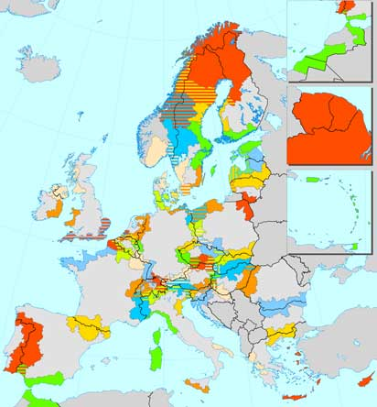
Romania CBC map 2004-2013

Slide 8
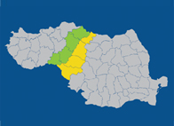
HU- RO CBC cooperation

Slide 9
HU-RO Program
Priority 1: Improve the key conditions of joint, sustainable development of the cooperation area (Improvement of cross-border transport, communication and environmental protection)
Priority 2: Strengthen social and economic cohesion of the border area (Cooperation in the fields of business, RTD, education, labor market, health care and risk management)

Slide 10
My experience:
CBC HU-RO between 2009 and 2013
126 secondary roads crossing the common border
2 highway interconnectors
1 gas pipeline interconnector
1 water pipeline crossing border
Medical care systems: Timisoara and Szeged
Communication optic wire
Common urgency assistance at tel. 112
Local administration cooperation
Enhancing occupation rate in border region
Enhancing cultural events
Cross border clusters: industrial, commercial, research, medical

Slide 11
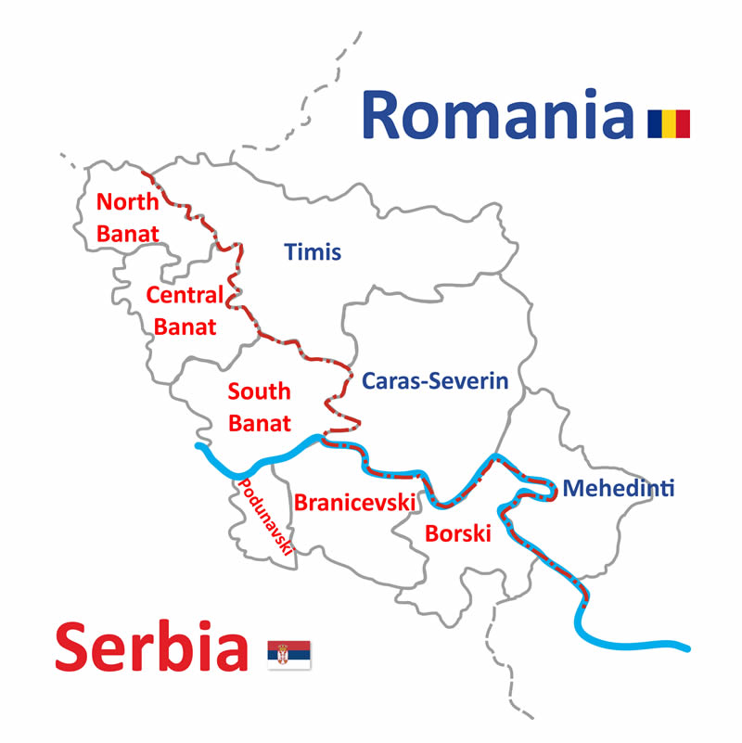
CBC 2007-2013 RO SRB – eligibile counties
Priority Axis 1– Economic and Social
Development
► Priority Axis 2 – Environment and Emergency
Preparedness
► Priority Axis 3 – Promoting “people to people”
exchanges
► Priority Axis 4 – Technical Assistance
Total funds: 62,448 million euro
from IPA 53,116 million euro

Slide 12
Priority Axis for 2014-2020 reflects strategy and financial allocation
The overall Program budget comprises of 74.906.248 EUR (IPA contribution), respectively 88.124.996 EUR (total budget):
5 priority axes
Financial budget allocated for each priority axe based on principles presented in following slides

Slide 13
Methodology of strategy definition: bottom up logic of strategy diagnostics combining needs, challenges and potentials.
Based on the findings of the SWOT analyses several strategic responses were formulated using the “forward linkages” method. This method identifies four types of responses as outlined below:
growth accelerating combining strengths and opportunities and aiming exploitation of comparative advantages;
structures adjustment responses, combining weaknesses and opportunities, aiming at the engagement of structural deficits and the sustainability of socioeconomic growth;
stabilization responses, combining strengths and threats, aiming at compensating negative trends and processes beyond the control of the region;
Preventive responses, combining threats and weaknesses, aiming at the precaution and mitigation of negative developments which affect economic growth.

Slide 14
Strategy definition
Systemic definition and delimitation of main challenges and untapped potentials, as well as the financial allocation to each Priority was defined taking into consideration feedback received from the consultation with the stakeholders having in mind:
The proportionality to the challenges and needs emerged in the analysis of the eligible area and addressed by each priority;
The project generation capacity estimated on the basis of the lessons learned from the previous programming period;
The expected financial size of the operations proposed, taking into account the technical content, the physical size, the territory targeted, the number and/ or the typology of target groups considered;
The project ideas and proposals collected during the consultations for programming with stakeholders and program partners, especially for strategic projects;

Slide 15
  Priority Axis 1 : Employment promotion and services for an inclusive growth
The planned IPA allocation to Priority Axis 1 is 15.460.624 EUR corresponding to 20,64% of the total IPA funds. The allocation is based on three main justifications:
The local stakeholders proved a strong capacity to generate projects during the previous programming period, in the fields of the cooperation for social inclusion projects, health care services, cultural cooperation, and the experiences will be surely capitalized in the next programming period;
Some of the actions proposed may include investments in infrastructure and equipment, with costs larger than those for soft actions;
The actions proposed can produce relevant impact in all communities in the eligible areas, and the number of projects proposals expected is very large; The financial allocation to this priority is in line with the emphasis given within the eligible area and also with the demand from the base as expressed during the period 2007-2013 and within the consultations during programming.

Slide 16
Priority Axis 2 : Environmental protection and risk management
  The planned IPA allocation to Priority Axis 2 is € 17.977.500 EUR, corresponding to 24% of the total IPA funds. The allocation is based on three main justifications:
Some of the actions proposed may include investments in infrastructure and equipment, with costs larger than those for soft actions;
Experience: partners have already produced a large portfolio of strategic projects ideas which include investments in infrastructure and technologies;
Support some strategic actions that will be particularly relevant for the coordination with the EUSDR; The financial allocation within this Priority Axis is justified by the actions envisaged in the pursuit of Specific Objective and also by the potentially cost-intensive outputs under Specific Objective.

Slide 17
Priority Axis 3: Sustainable mobility and accessibility
  The planned IPA allocation to Priority Axis 3 is € 17.977.500 EUR, corresponding to 24% of the total IPA funds. The allocation is based on three main justifications:
During the previous programming period the number of projects implemented in these fields was relatively lower than in other areas.
However, the partners have produced a large portfolio of strategic projects ideas, which include investments in infrastructures, project designs for large infrastructures, regeneration of existing infrastructures.
The Priority can support some strategic actions that will be particularly relevant for the coordination with the EUSDR strategy. This financial allocation reflects the expected size of actions facing the needs to support

Slide 18
Priority Axis 4 : Attractiveness for sustainable tourism
  The planned IPA allocation to Priority Axis 4 is € 16.000.000 EUR, corresponding to 21,36% of the total IPA funds. The allocation is lower than the average of the 4 priorities, based on three main justifications, that lead to the expectation of a large number of projects with a lower average cost than in other areas:
  During the previous programming period a significant number of projects were implemented in these fields, but the average costs of these projects was smaller than in other areas, especially because most of the projects consisted of “soft” activities.
The Priority can support some actions that will be particularly relevant for the coordination with the EUSDR, but these actions most probably will consist of “soft” activities, rather than investments in infrastructure.

Slide 19
  Priority Axis 5: technical assistance
The allocation for technical assistance corresponds to the 10% of the total allocation. The allocation is based on two main justifications
The experience of the current programming period, which proves that program partners and potential beneficiaries need a strong support for the generation and implementation of projects, in order to avoid ineligible costs and to increase the overall absorption rate.
The strategy for the new program has identified ambitious objectives, including strategic projects and a strong coordination with regional and EU strategies (EUSDR).

Slide 20
Last but not the least
With hope to have similar good results at CBC projects as I presented in my previous experience, please do not hesitate to contact me to find Romanian partners:
dr. Stefan Imre, minister counsellor
Embassy of Romania in Belgrade
Str. Uzicka 10
Email: belgrad.economic@mae.ro

